Slide 1
WORLD OF LASERS
Laser Application: Communication

Slide 2
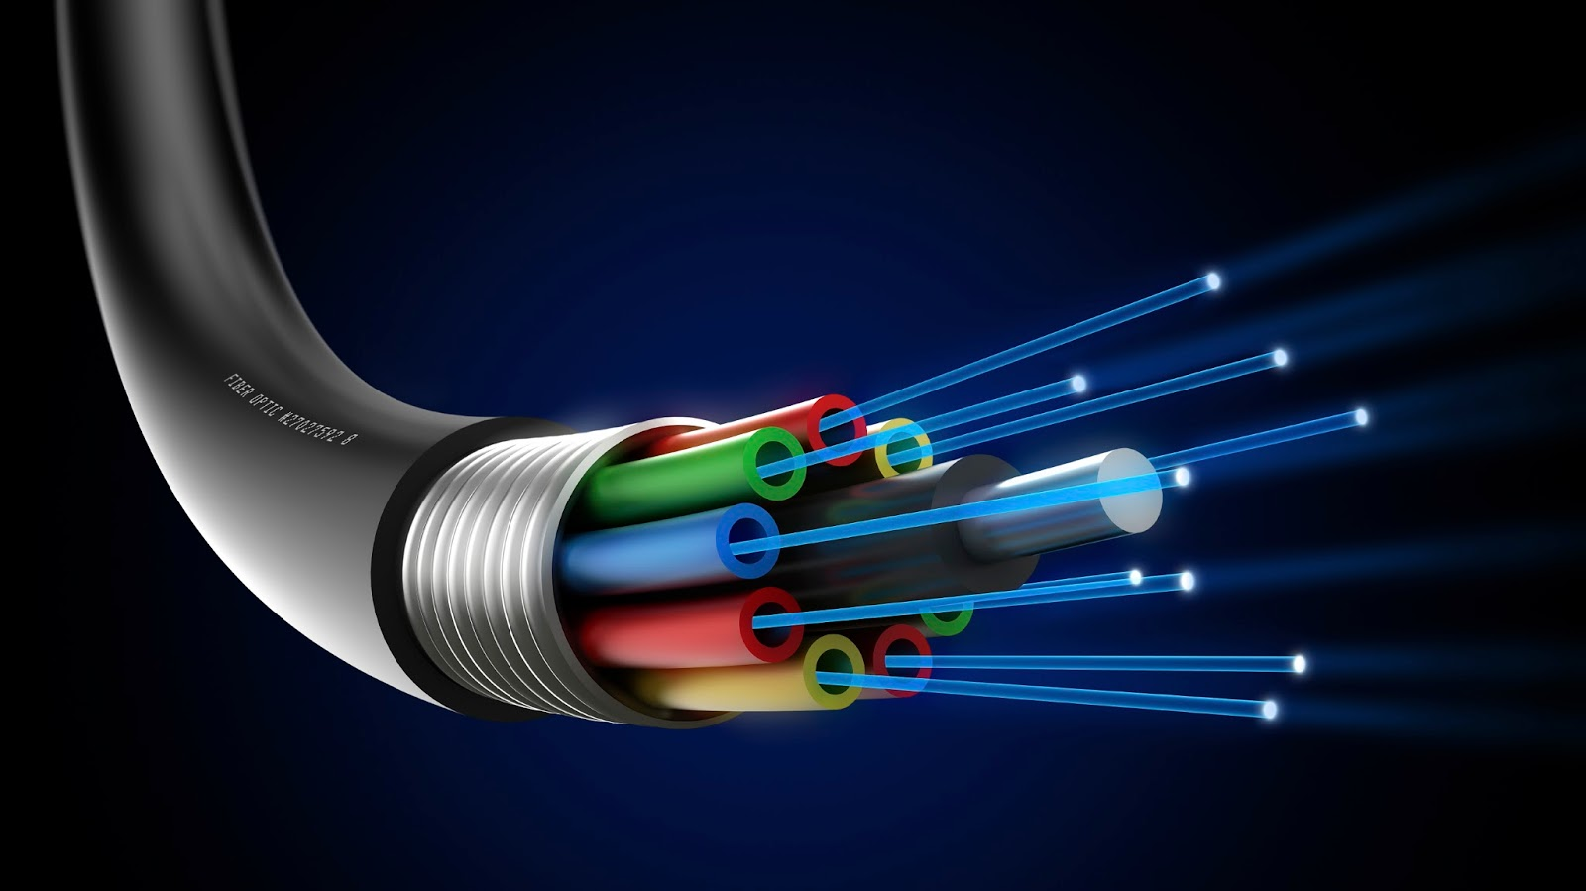
COMMUNICATION
Optical fiber communication, extensively used particularly for long-distance optical data transmission, mostly relies on laser light in optical glass fibers.

Slide 3
COMMUNICATION

Slide 4
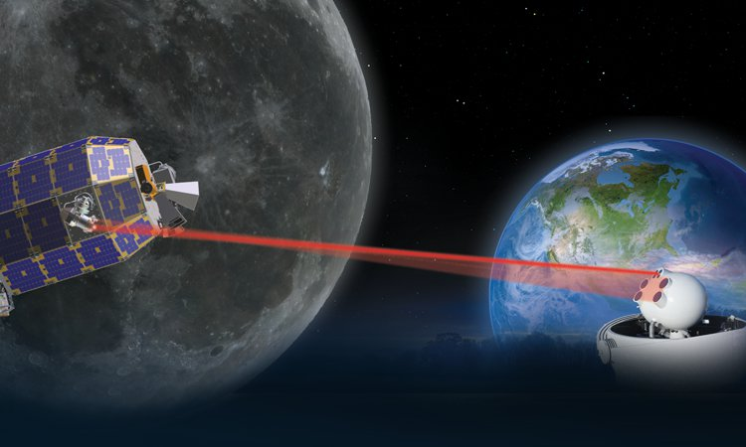
COMMUNICATION
Free-space optical communications (e.g. inter-satellite communications). Laser beams propagate over large distances with small beam divergence.

Slide 5
?
WELL DONE!
Move on to the next laser application...
DISPLAY!

